Slide 1
Resource Allocation Formula (RAF): Rationale and Options
Malawi Sun Hotel, Blantyre
22 February 2019

Slide 2
Overview
Which part of the budget?
Why RAF?
What variables?
Proposed Options
To WHICH parts of the budget will the Resource Allocation Formula (RAF) be applied?
WHY is a RAF needed?
WHAT VARIABLES should be included in the formula?
Proposed OPTIONS

Slide 3
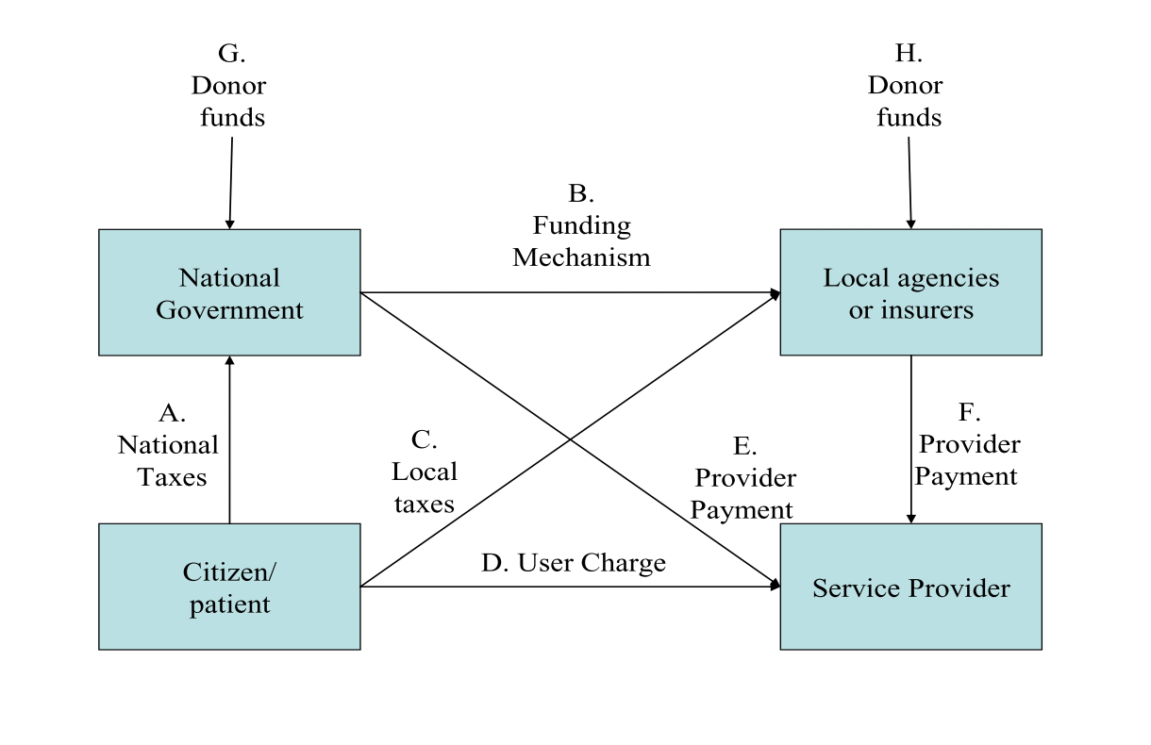
Flow of funds in the health system
Which part of the budget?
Why RAF?
What variables?
Proposed Options
The focus of this session
Notes:
flow of public funds implicit in the finance of most health systems.
- Focus on the flow of funds from the national government to local agencies with the objective to aligning its functions to the national policy objectives

Slide 4
Malawi Health Sector Financing Flow
Which part of the budget?
Why RAF?
What variables?
Proposed Options
Ministry of Health and Population (MOHP)
Ministry of Local Government (MOLG)
29 District Health Offices (DHOs)
5 Quality Management Offices (QMOs)
District Councils
Treasury
The Health Sector ORT* and Drug Budget Ceiling is set by Treasury.
MOLG allocates the ORT, and Drug budget** across districts based on historical distribution. PE Budget is allocated based on staff on payroll.
District Councils transfer the health sector budget to DHOs.
DHOs allocate budgets to District Hospitals, Health Centers, Community Hospitals, Health Posts and Clinics.
* ORT – Other Recurrent Transactions; PE - Personnel Emoluments
** Note: the ORT and PE Budgets for Education and Agriculture sectors are similarly decentralized.

Slide 5
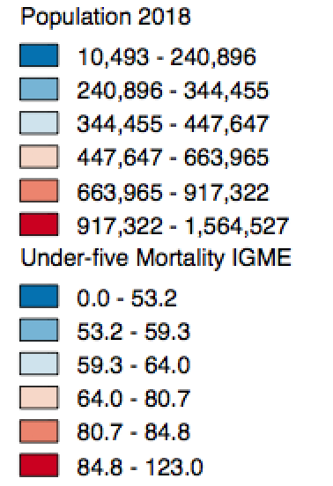
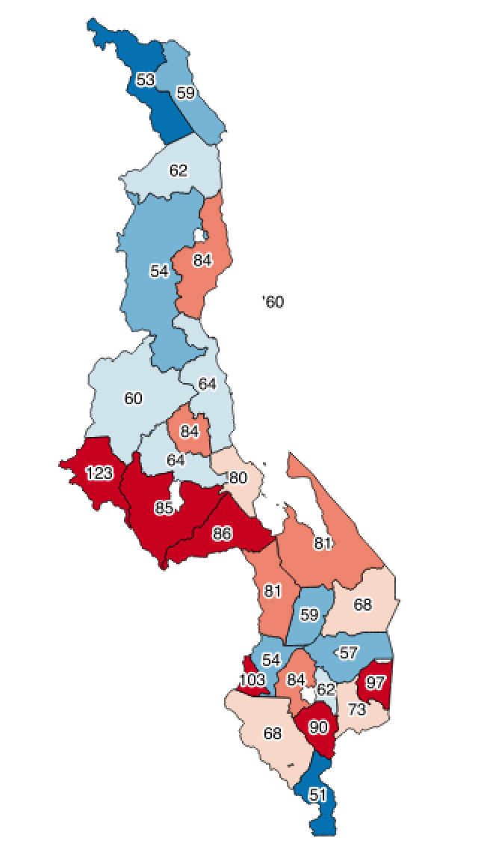
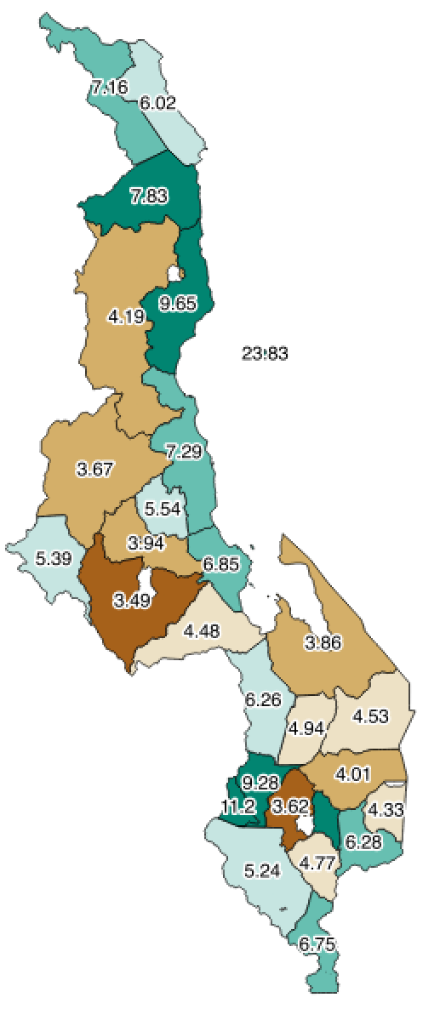
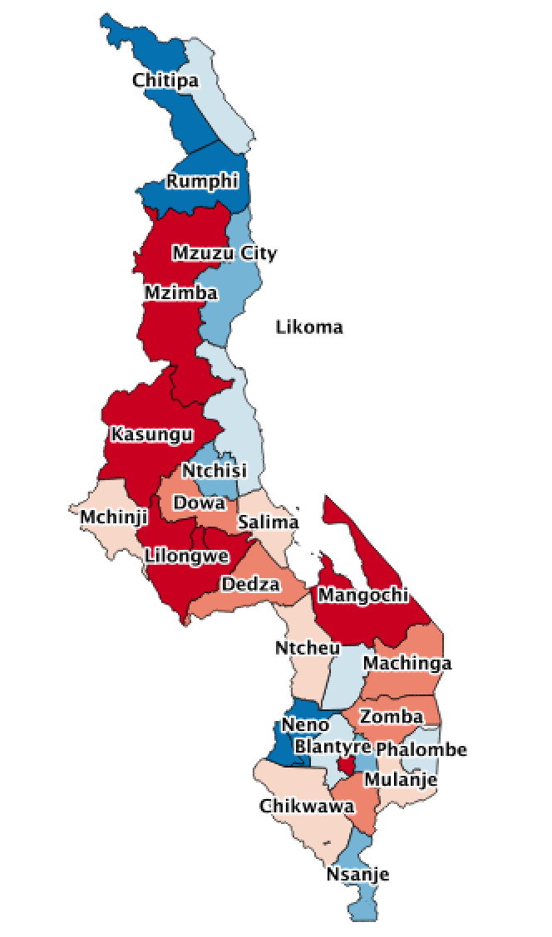
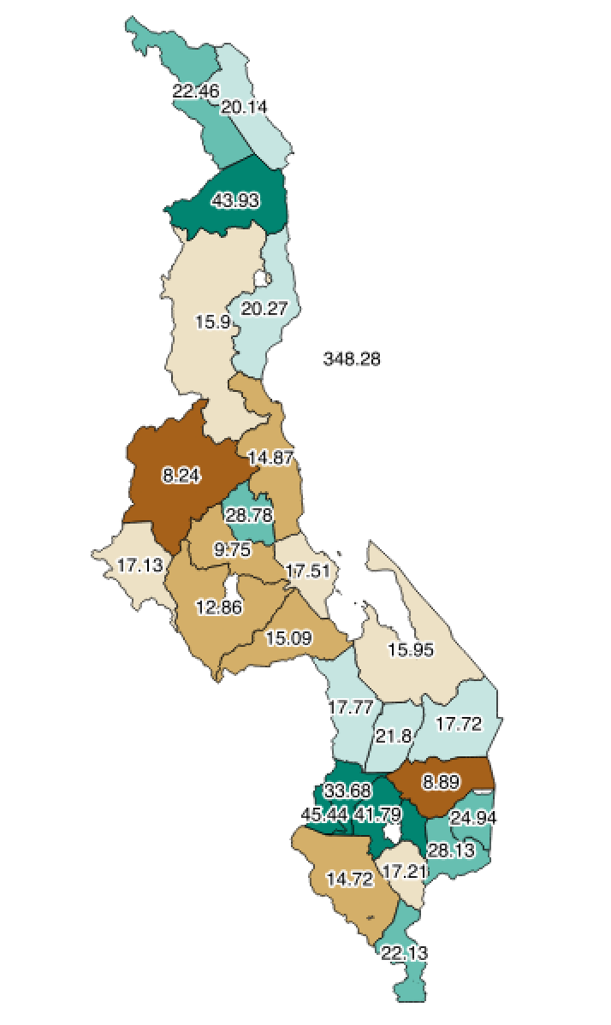
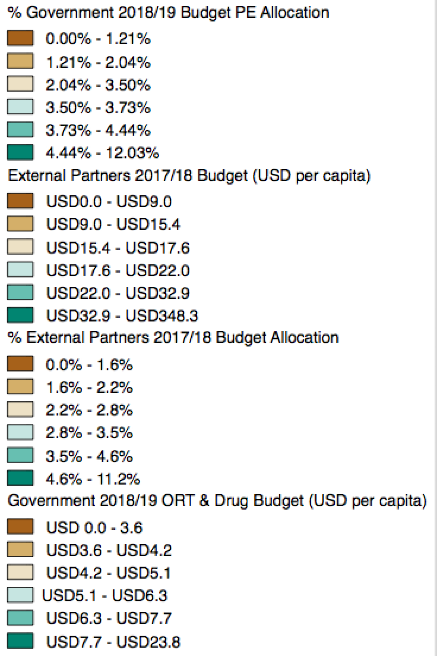
Population, Mortality, Budget
Which part of the budget?
Why RAF?
What variables?
Proposed Options
Population (2018)
Under-five Mortality (2016)
Deaths per 1000
ORT & Drug Budget (2018/19)
USD per capita
Total External Budget (2017/18)
USD per capita
Source: NSO Projections 2008
Source: DHS 2016 (EQUIST)
Source: NLGFC + NSO
Source: Resource Mapping 2017-2020 + NSO

Slide 6
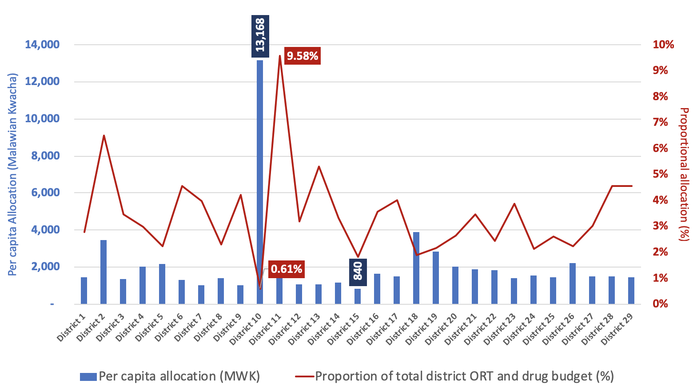
Resource Allocation (2018/19)
Which part of the budget?
Why RAF?
What variables?
Proposed Options
Figure: Current Drug and ORT Budget Allocation in Malawi (FY 2018/19) – prior to the formula
Note: District names have been anonymized to maintain focus on the fairness of the logic behind the allocations rather than the outcomes
Notes:
To access services at a central hospital a patient must be referred from a lower level of care or, if not referred, pay a bypass fee. However, keep attention on the science behind setting a formulae perceived to be fair rather than focusing on the outcomes of any decisions on the formulae.

Slide 7
Rationale for Formula Funding
Which part of the budget?
Why RAF?
What variables?
Proposed Options
Efficiency: Allocative and Managerial
Equity: Horizontal and Vertical
Political considerations
Notes:
The two most fundamental notions are allocative efficiency (the extent to which allocations of resources are in line with society’s preferences) and managerial efficiency (the extent to which agencies perform functions at least resource cost).
Horizontal equity suggests equal treatment of equals, vertical equity suggests that those who are in more need (however that need is defined) should in some sense with higher priority - ‘standard’ benefit package of health services.
Political considerations such as: allowing the criteria for funding to be set out explicitly; treating the budget-setting process systematically; promoting accountability; binding politicians, bureaucrats and other parties to a set of distributional rules; and helping to provide a non-partisan solution to intense political conflicts.

Slide 8
Approaches to Funding
Which part of the budget?
Why RAF?
What variables?
Proposed Options
Approach |  | Challenge
Political Patronage |  | No economic argument
2. Historical Precedent |  | Perpetuation of existing inequities
3. Local bids |  | Administratively costly
4. Actual spending |  | Perverse incentive to increase expenditure
5. Mathematical Formula | 5A. Case-based (Actual level of local activity) | Perverse incentives, Cream-skimming
 | 5B. Expected level of local activity | Appropriate modelling of needs
Notes:
Political patronage: rewarding localities according to their political support in the past, or their importance for the government in the future
Historical precedent: Local agencies continually funded based on budgets provided during the previous years. . * Minimise year-on- year disruption to existing services but leave the government hostage to history and perpetuates existing unfairness
Local bids: Bids or some measure of performance - While this mechanism could be agreeable it is technically and administratively challenging.
Actual Spending – pervese incentive to spend inefficiently and excessively
Formula - mathematical rules that determine the magnitude of the funding received by a local agency are specified in advance.
Case – based - counts of inpatients, and the highly developed systems of diagnosis-related groups (DRGs) in place in many developed countries. They are especially relevant when an unambiguous indicator of a patient’s need for the service can be established. → should be as independent as possible from the actual data and performance of local providers
Expected level of local activity - infers the expected level of local service expenditure, providing local agencies with a fixed budget without reference to actual local health service use. They can circumvent some of the perverse incentives inherent in case payment, but their effectiveness depends on how successfully the capitation payments are adjusted to account for variations in population characteristics.

Slide 9
Elements of Capitation Funding (1)
Which part of the budget?
Why RAF?
What variables?
Proposed Options
Explicit objective: eg. efficiency of insurance market operations, equity (give local agencies the opportunity to provide a standard package of health services)
Entities in receipt of funds: eg. small, single purpose health agencies are at greater risk in case of an inaccurate formula
Services covered: line-by-line estimate of each component of the health benefits package or demographic variables
Categories of expenditure: Drug costs, personnel costs, other recurrent costs, capital investments
Notes:
Objectives of the funding formula: Standard benefit package – integrates the government’s objectives of equity, efficiency, and sustainability
Entities in receipt of funds - Financial risk is central to any consideration of the administrative level at which the finance is to be directed. Broadly speaking, larger entities are more able to absorb such risk than smaller entities, because any inaccuracy in the formula can be absorbed across a large population. A simple per capita funding mechanism may be adequate for distributing funds from central to provincial government, because the provinces have broadly similar demographic profiles, and because they have access to a range of other funding sources with which to abate any inaccuracies in estimates of spending need.
Services covered by the formula - At one extreme, a formula might be based on line-by-line estimates of needs and costs for each element of the benefits package, possibly implying different formulae for each service in the package. This might entail using statistical models to derive unbiased estimates of the expected number of service users for each service. At the other extreme, a single broad formula might be used for all services, based on simple available metrics, such as demographic variables and mortality rates.
Categories of expenditure -
Counting the population – relevant demographic groups (eg. Maternity services), citizens who choose to “opt out” of public health services and use private care (or covered by insurance)
Risk adjustment - (a) the probability of requiring services and (b) the intensity of use associated with that need. The trade-off between parsimony and sensitivity
Measuring costs - However, it may also be important to model the third element – the costs to the local agency – with some care if there are significant legitimate input price variations between localities.
Cross border flows - The adjustment for any cross-border flows then entails a separate adjustment between individual local agencies, which will often be made only after the net flow of patients becomes known.

Slide 10
Elements of Capitation Funding (2)
Which part of the budget?
Why RAF?
What variables?
Proposed Options
Counting the population: source of data, demographic groups with different health needs, citizens not using public healthcare
Risk-adjustment: modelling probability of requiring services and intensity of service use
Challenges – administratively demanding data collection, possibility of misrepresentation by local authorities, rewarding local agencies for poor historical performance, perverse incentives for increased provision of services, parsimony versus sensitivity
Measuring costs: Probability of need for services, intensity of service use, cost of service provision, cost-sharing arrangements
Cross-border flows: difficult to account for unless the net flow of patients is known
Notes:
5. Counting the population - most countries have a reliable source to estimate population by regions; relevant sub-groups with different health needs and accessing health care from different providers
6. Risk adjustment - supplement the basic demographic disaggregation with epidemiological indicators, - more refined predictions of spending need. Probability of requiring a service X Intensity of service use
Eg. HIV which requires lifelong treatment would impose a higher resource burden than malaria.
Parsimony leads to greater accountability whereas sensitivity ensures greater accuracy
7. Measuring costs – cost of service delivery and cost sharing arrangements
8. Cross-border flows – (E-Swatini) difficult to account for unless the actual numbers are known

Slide 11
Background: Resource Allocation in Malawi (1)
Which part of the budget?
Why RAF?
What variables?
Proposed Options
Current allocation mechanism – historical precedent
In 2008, a formula based on five-weighted factors was developed –
50% population weighted by stunting
15% population weighted by infant mortality rate
15% population weighted by OPD utilization rates
15% bed capacity
5% geographical size
Notes:
To access services at a central hospital a patient must be referred from a lower level of care or, if not referred, pay a bypass fee.

Slide 12
Which part of the budget?
Why RAF?
What variables?
Proposed Options
Background: Resource Allocation in Malawi (2)
A capitation method (risk-adjusted) was chosen for the following reasons:
Encourages appropriate preventative measures for services where this is an important objective;
Removes the incentive for supplier-induced demand, which can be a problem under case payment;
Reduces reliance on output data provided by local providers; and
Can be aligned with national equity objectives.
This formula was applied for a short period of time and then the system reverted to historical allocation.

Slide 13
1. Demographic factors
Which part of the budget?
Why RAF?
What variables?
Proposed Options
Population (2018)
Under-five Mortality (2016)
Deaths per 1000
CHALLENGE:
Districts with consistently high fertility rates and high mortality rates should not be rewarded indefinitely.
Source: NSO Projections 2008
Source: DHS 2016 (EQUIST)

Slide 14
2. Burden of Disease
Which part of the budget?
Why RAF?
What variables?
Proposed Options
CHALLENGE:
Accurately estimating the district-level burden of disease can be difficult.
Source: IHME, 2018

Slide 15
3. Service Delivery Factors
Which part of the budget?
Why RAF?
What variables?
Proposed Options
Cost of delivering health interventions:
Drug costs
Program management costs
Number of cases:
Prevalence of condition requiring treatment
Coverage rates
CHALLENGE:
Estimating program management costs of health interventions can be difficult
Allocating a lower budget to districts with lower coverage rates would provide limited scope to expand coverage
Source: IHME, 2018

Slide 16
4. Geographic distribution of facilities
Which part of the budget?
Why RAF?
What variables?
Proposed Options
District | Number of facilities* | Number of facilities (% of total) | Average distance between DHO and facility (kms)
Mzimba | 51 | 10.1% | 49.7
Lilongwe | 46 | 9.1% | 23.8
Mangochi | 33 | 6.4% | 32.8
Zomba | 31 | 6.2% | 11.7
Blantyre | 28 | 5.6% | 11.7
Kasungu | 28 | 5.4% | 30.7
Dedza | 25 | 4.8% | 29.3
Ntcheu | 22 | 4.3% | 21.3
Chikwawa | 21 | 4.1% | 29.2
Nkhata Bay | 19 | 3.7% | 33.1
Dowa | 18 | 3.5% | 27.5
Mulanje | 18 | 3.5% | 16.9
Thyolo | 17 | 3.3% | 14.9
Karonga | 16 | 3.1% | 31.8
Machinga | 15 | 2.9% | 41.6
Nkhotakota | 13 | 2.5% | 34.0
Rumphi | 12 | 2.3% | 28.0
Chiradzulu | 12 | 2.3% | 12.6
District | Number of facilities | Number of facilities (% of total) | Average distance between DHO and facility (kms)
Nsanje | 11 | 2.1% | 26.7
Ntchisi | 11 | 2.1% | 12.9
Salima | 11 | 2.1% | 17.1
Mchinji | 11 | 2.1% | 28.0
Phalombe | 10 | 1.9% | 14.2
Balaka | 8 | 1.5% | 20.3
Neno | 8 | 1.5% | 12.2
Chitipa | 7 | 1.4% | 30.1
Kasungu | 5 | 1.0% | 33.8
Mwanza | 4 | 0.8% | 11.0
Likoma | 2 | 0.4% | 6.4
CHALLENGE:
It is important to account for the relationship between the number of facilities and their geographical distribution with expected expenditures.
* Facilities include District hospitals, Rural/Community hospitals, Health centers, Clinics and Dispensaries

Slide 17
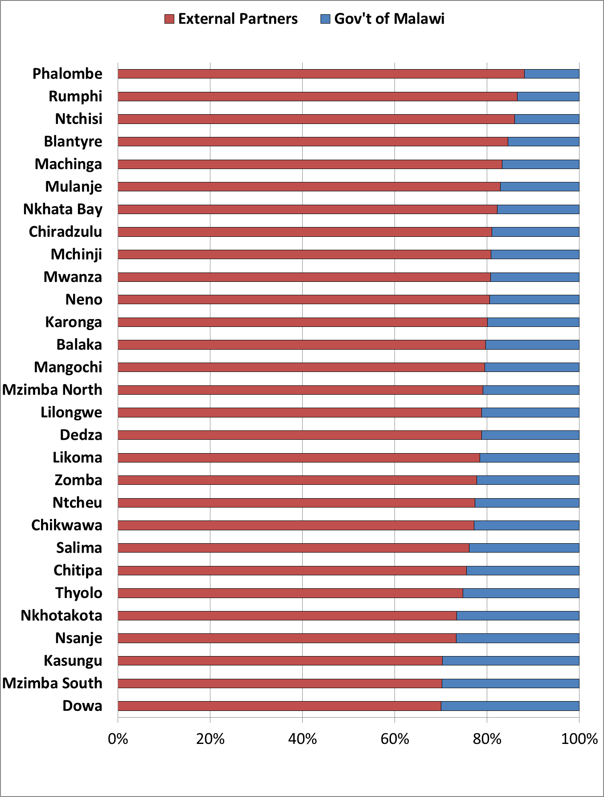
5. Donor contributions
Which part of the budget?
Why RAF?
What variables?
Proposed Options
CHALLENGE:
Reducing government funding to districts with large donor support can increase donor dependency.
Figure: Health Sector Funding earmarked for Districts by Financing Source (FY 2017/18)
Source: Resource Mapping 2017-2020

Slide 18
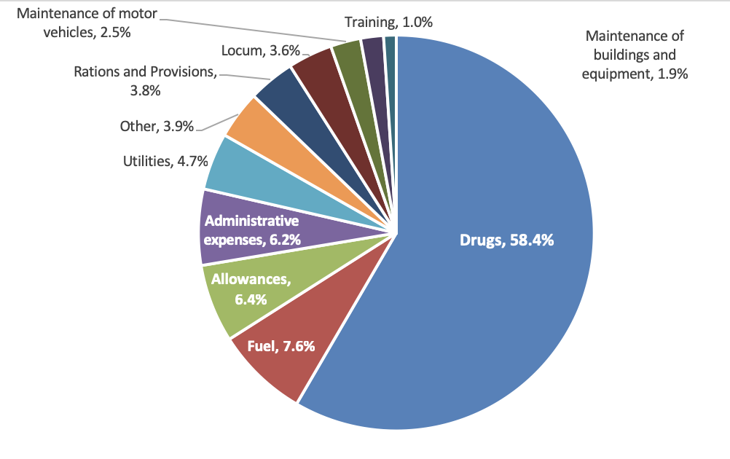
What are district budgets used for?
Which part of the budget?
Why RAF?
What variables?
Proposed Options
Figure: Breakdown of the 2017/18 District ORT Budget

Slide 19
Which part of the budget?
Why RAF?
What variables?
Proposed Options
Initial Work on Resource Allocation Formula Options
Notes:
Now that we’ve seen seen how a RAF could improve the way in which resources are shared between districts as well as some factors that can be considered, we move onto a presenting some options that were developed by the Ministry of Health.

Slide 20
RAF Options
Which part of the budget?
Why RAF?
What variables?
Proposed Options
Broad demographic proxies
Crude population allocation
Standardized mortality rate allocation
EHP intervention need (Full coverage)
EHP intervention need (Realistic coverage)
EHP intervention need (Excluding partner contributions)
Detailed
cost
estimation
Notes:
- We will go through 5 options. These options are to be understood broad frameworks to which further adjustments can be made. As we go through this part of the presentation, I would urge you to think about which option is the most fair according to you as well as other factors you would wish to be added to the formula.
- The first two options use a proxy indicator to estimate expected health expenditures in the district. The last three options try to estimate the total cost of delivering every intervention in the Essential Health Package based on population size, disease burden and the cost of drugs and commodities.

Slide 21
Proposed Options
Option 1: Crude Population Allocation
1. Crude population
2. Mortality Rates
3. EHP Cost
Total Population
Fixed Per Capita Allocation
FY 2018/19
MK 1,266 per person*
MK1.26 billion
1,000,000
people
MK1,266
Notes:
A district with 1 million people would get 1,2 billion

Slide 22
Proposed Options
Option 2: Age-standardized Mortality Rates
1. Crude population
2. Mortality Rates
3. EHP Cost
Standardized Mortality Rate
Fixed Allocation per death
FY 2018/19
MK 1.8 million per death
1,000,000
people
MK1.8 billion
1,000
deaths
MK1.8 million
Notes:
Mortality rates might offer a better proxy of health needs of a district than crude population size.
A district with 1 million people and 1,000 deaths → 1.8 billion MWK

Slide 23
Proposed Options
Crude Mortality Rate vs. Standardised Mortality Rate
1. Crude population
2. Mortality Rates
3. EHP Cost
Allocation under Crude Mortality Rates
Age group | District A |  |  | District B
 | Population | Number of deaths | Age-specific mortality rate | Population | Number of deaths | Age-specific mortality rate
Age group 1 | 20,000 | 440 | 22 | 28,000 | 616 | 22
Age group 2 | 19,000 | 171 | 9 | 17,000 | 153 | 9
Age group 3 | 16,000 | 128 | 8 | 14,000 | 112 | 8
Age group 4 | 13,000 | 130 | 10 | 11,000 | 110 | 10
Age group 5 | 12,000 | 120 | 10 | 10,000 | 100 | 10
Total | 80,000 | 989 |  | 80,000 | 1,091
48%
52%
Notes:
Using the standardised mortality rate improves on the per capita formula by capturing district variations in mortality, separate from their demographic structure, there remain a number of issues.

Slide 24
Proposed Options
Crude Mortality Rate vs. Standardised Mortality Rate
1. Crude population
2. Mortality Rates
3. EHP Cost
Allocation under Standardized Mortality Rates
Age group | National | District A |  | District B
 | Average Population per district | Age-specific mortality rate | Standardised number of deaths | Age-specific mortality rate | Standardised number of deaths
Age group 1 | 24,000 | 22 | 528 | 22 | 528
Age group 2 | 18,000 | 9 | 162 | 9 | 162
Age group 3 | 15,000 | 8 | 120 | 8 | 120
Age group 4 | 12,000 | 10 | 120 | 10 | 120
Age group 5 | 11,000 | 10 | 110 | 10 | 110
Total | 80,000 |  | 1,040 |  | 1,040
50%
50%
Notes:
While using the standardised mortality rate improves on the per capita formula by capturing district variations in mortality, separate from their demographic structure, there remain a number of issues. As previously outlined, the formula should reflect the expected cost of delivering a standard package of services local agencies are expected to provide. Therefore, while the above formula based on standardised mortality rates may bring the district allocation closer in line with districts relative health care need than a per capita allocation, it does not account for the services districts are expected to provide.

Slide 25












The Essential Health Package outlines a minimum package of cost-effective interventions to be delivered free to all Malawians
Proposed Options
1. Crude population
2. Mortality Rates
3. EHP Cost
The Essential Health Package
Intervention categories included in the Essential Health Package
RMNCH
Vaccines
Malaria
IMCI
Community Health
NTDs
HIV/AIDS
Nutrition
TB
NCDs
Oral Health

Slide 26
Proposed Options
1. Crude population
2. Mortality Rates
3. EHP Cost
Option 3: EHP intervention need (full coverage)
Total expected expenditure on drugs and commodities for one intervention
Number of patients requiring intervention
Cost per person per year by intervention
Target population size
Population in need (%)
Total expected drugs and commodities cost of deworming for pregnant women
Number of pregnant women
% of pregnant women who need deworming treatment
Cost of treatment
MK535,700
50,000
30%
MK36
Notes:
The formula should reflect the expected cost of delivering a standard package of services local agencies are expected to provide.

Slide 27
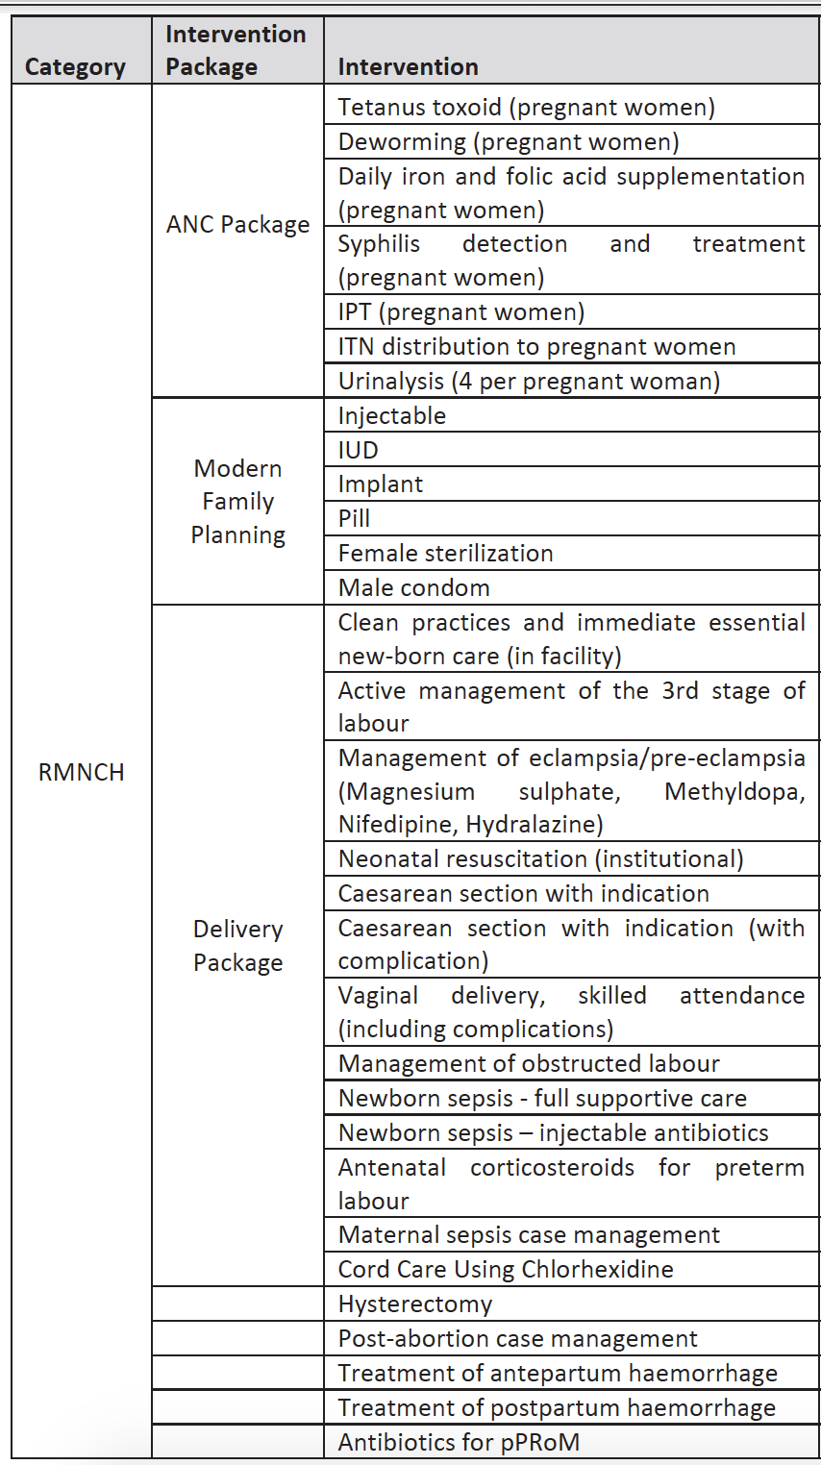
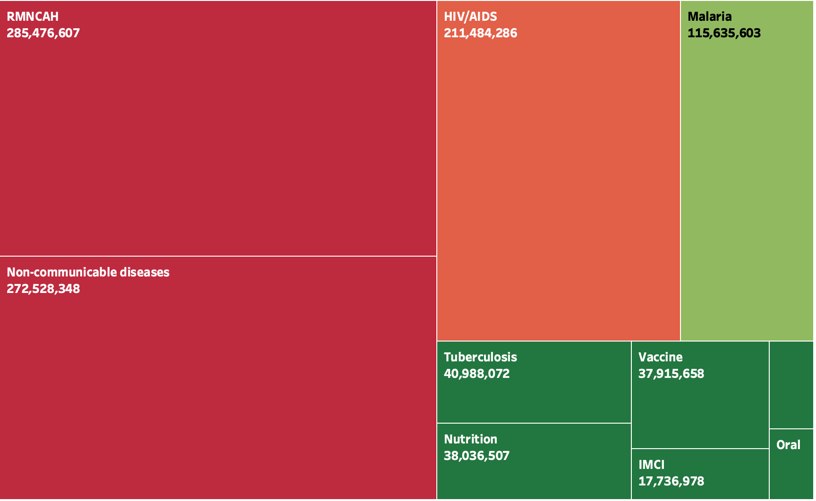
Proposed Options
1. Crude population
2. Mortality Rates
3. EHP Cost
Option 3: EHP intervention need (full coverage) The Case of District 1
Figure: Total EHP cost for District 1 (full coverage)

Slide 28
Proposed Options
1. Crude population
2. Mortality Rates
3. EHP Cost
Option 3: EHP intervention need (full coverage) The Case of District 1
Total EHP Cost
(Full coverage)
MK1.04 billion
Figure: Total EHP cost for District 1 (full coverage)

Slide 29
Option 4: EHP intervention need (realistic coverage)
Proposed Options
1. Crude population
2. Mortality Rates
3. EHP Cost
Total expected expenditure on drugs and commodities for one intervention
Number of patients requiring intervention
Cost per person per year by intervention
Realistic coverage rate
Total expected drugs and commodities cost of deworming for pregnant women
Number of pregnant women
% of pregnant women who need deworming treatment
Cost of treatment
Realistic coverage rate
MK484,142
MK36
90%
MK535,700
50,000
30%

Slide 30
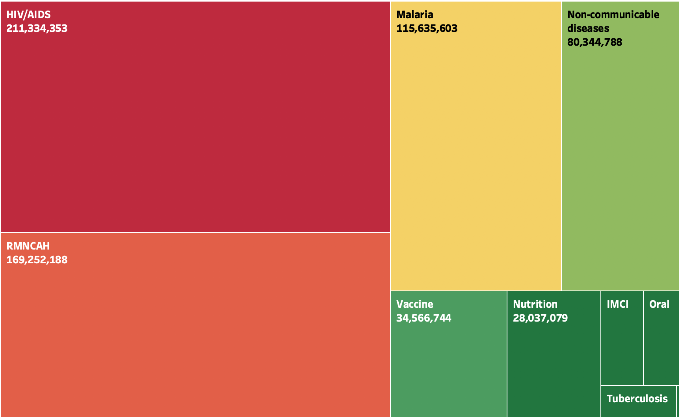
RAF Option 4: EHP intervention need (realistic coverage) The Case of District 1
Proposed Options
1. Crude population
2. Mortality Rates
3. EHP Cost
Total EHP Cost
(Realistic coverage)
MK662 million
Total EHP Cost
(Full coverage)
MK1.04 billion
Figure: Total EHP cost for District 1 (realistic coverage)

Slide 31
Option 5: EHP intervention need (excluding partner contributions)
Proposed Options
1. Crude population
2. Mortality Rates
3. EHP Cost
Total expected expenditure on drugs and commodities for one intervention
Number of patients requiring intervention
Cost per person per year by intervention
% of drugs and commodities budget funded by the govt.
Total expected drugs and commodities cost of deworming for pregnant women
Number of pregnant women
% of pregnant women who need deworming treatment
Cost of treatment
Govt. contribution
MK402,142
MK36
75%
MK535,700
50,000
30%

Slide 32
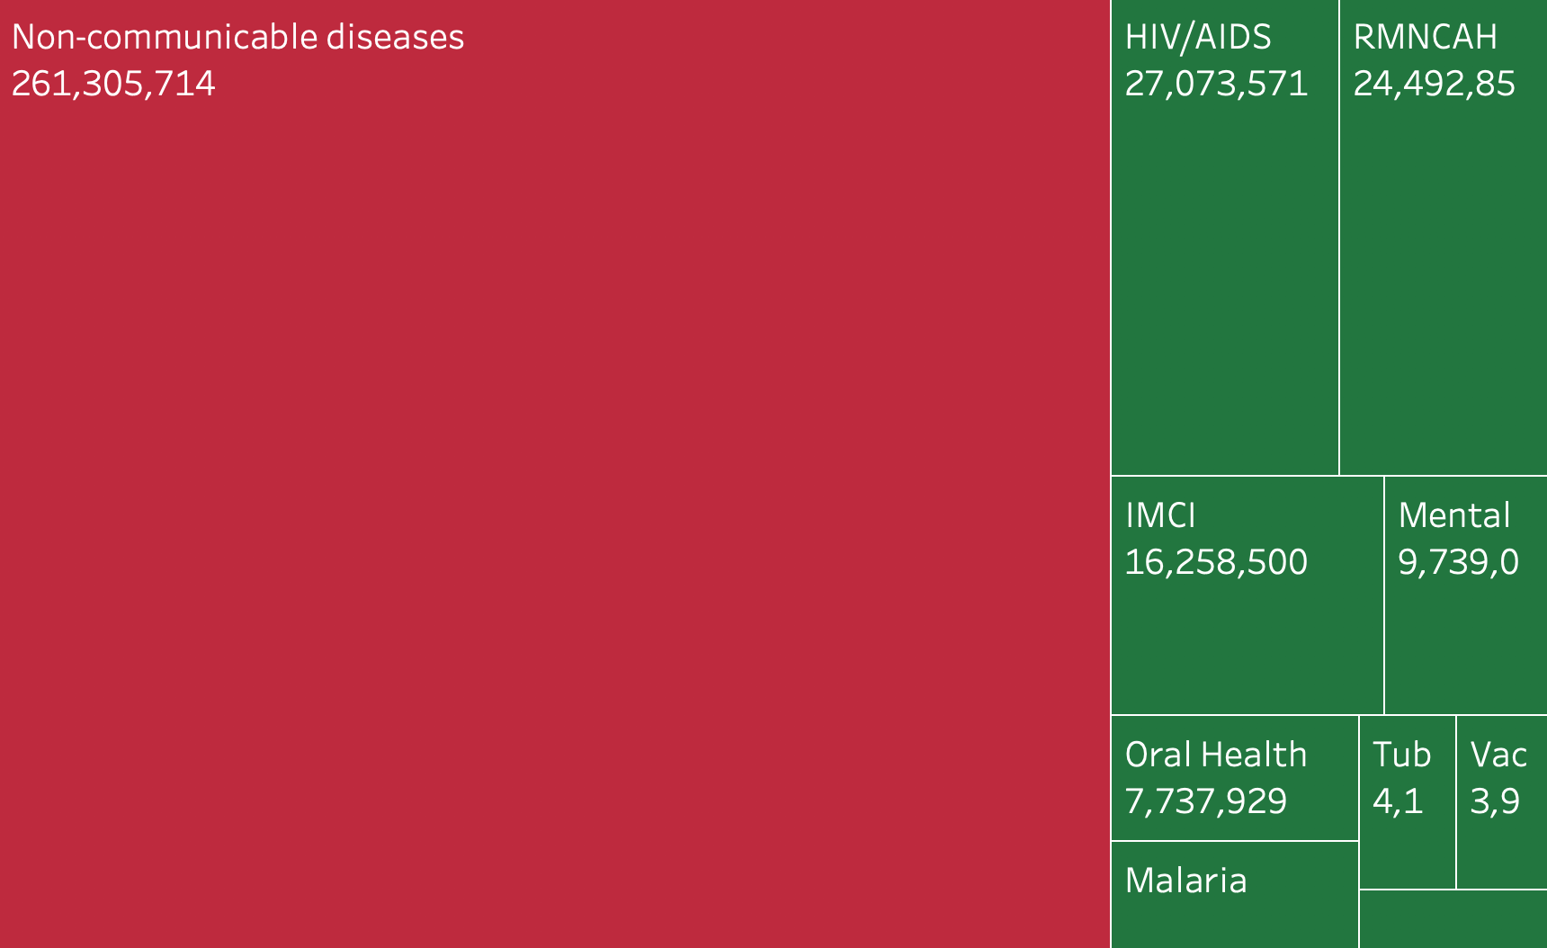
Option 5: EHP intervention need (excluding partner contributions) The Case of District 1
Proposed Options
1. Crude population
2. Mortality Rates
3. EHP Cost
Total EHP Cost
(exc. partner contributions)
MK364 million
Total EHP Cost
(Full coverage)
MK1.04 billion
Figure: Total EHP cost for District 1 (realistic coverage)

Slide 33
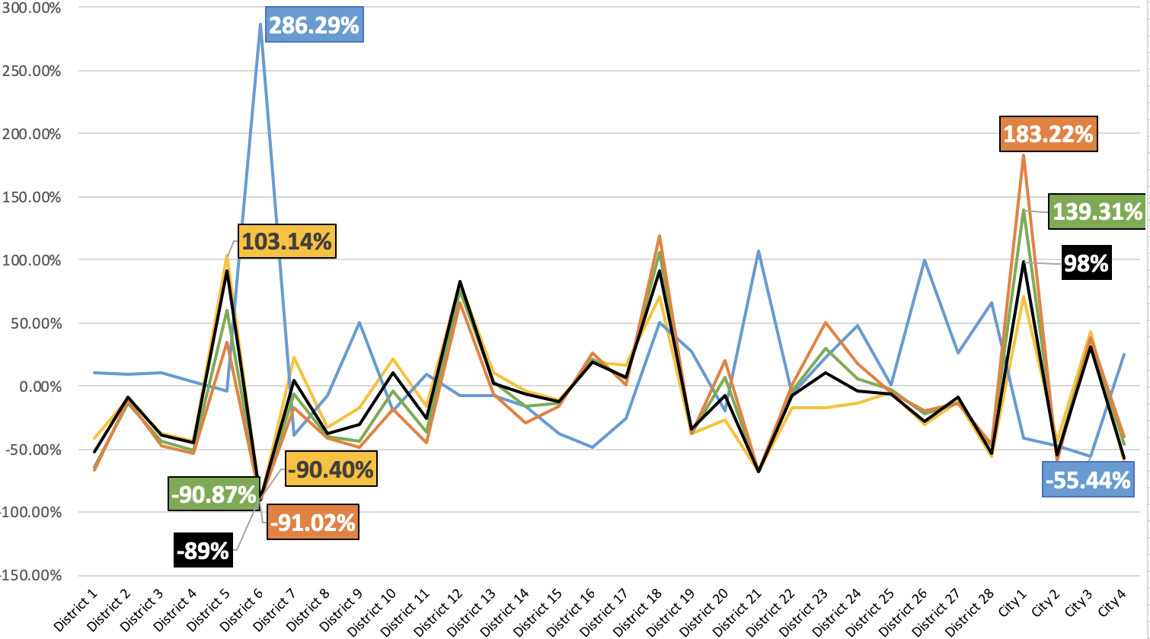
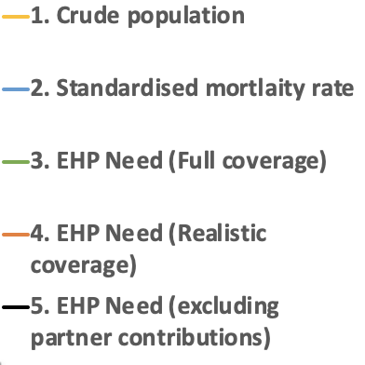
Comparison of Options
Which part of the budget?
Why RAF?
What variables?
Proposed Options

Slide 34
Pending Questions on RAF
Which part of the budget?
Why RAF?
What variables?
Proposed Options
Essential administrative expenditures
Cost Variations
Drug Budget Formula vs. ORT Budget Formula
Pace of Change
Frequency of revision

Slide 35
Resource Allocation Formula (RAF): Pace of Change Considerations
Grand Palace Hotel, Mzuzu
18 February 2019

Slide 36
Pace of Change Considerations
Considerations:
A large negative shock to the current budget will adversely affect regular operations
A large positive shock will be difficult to absorb
A long phase-in duration will postpone the adjustment of allocations to the “ideal” scenario
Notes:
District would not have enough time to scale down operations or improve efficiency in order to accommodate the reduction in budget
Districts would not have enough time to decide how to efficiently use additional resources
There might be a situation when the formula calculations change before the phase-in is complete.

Slide 37
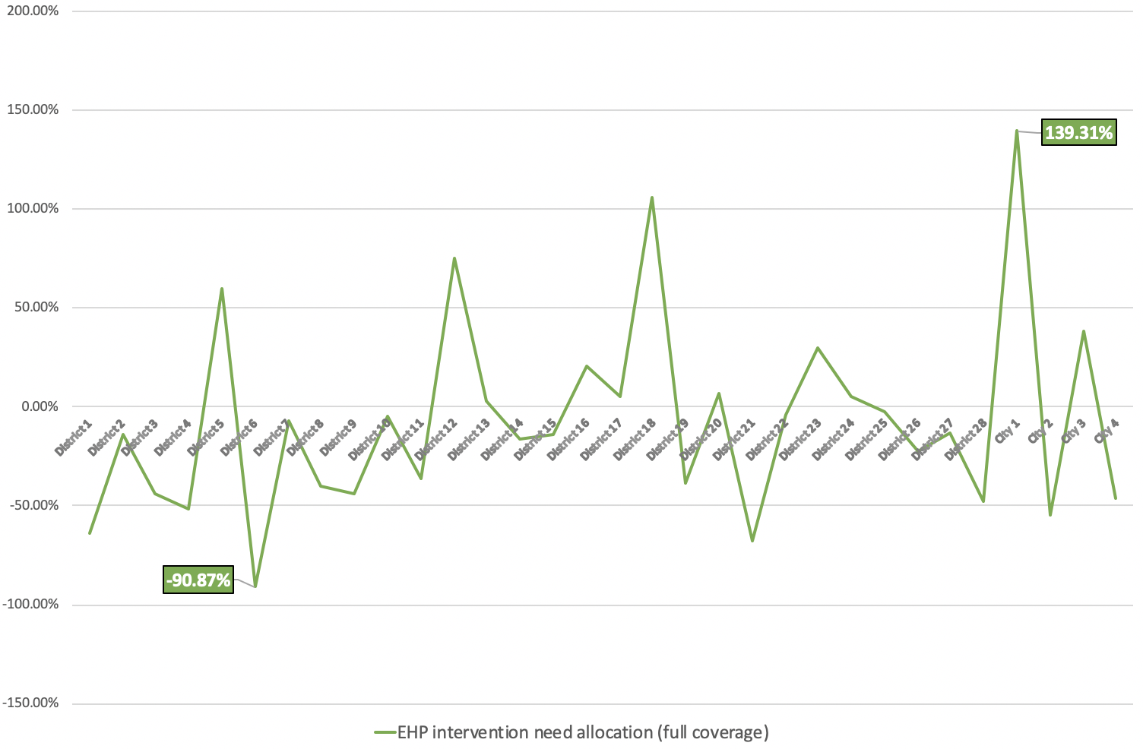
Pace of Change Simulations Option 3
Figure: Comparison of percentage change in budget share implied by RAF options to current allocation

Slide 38
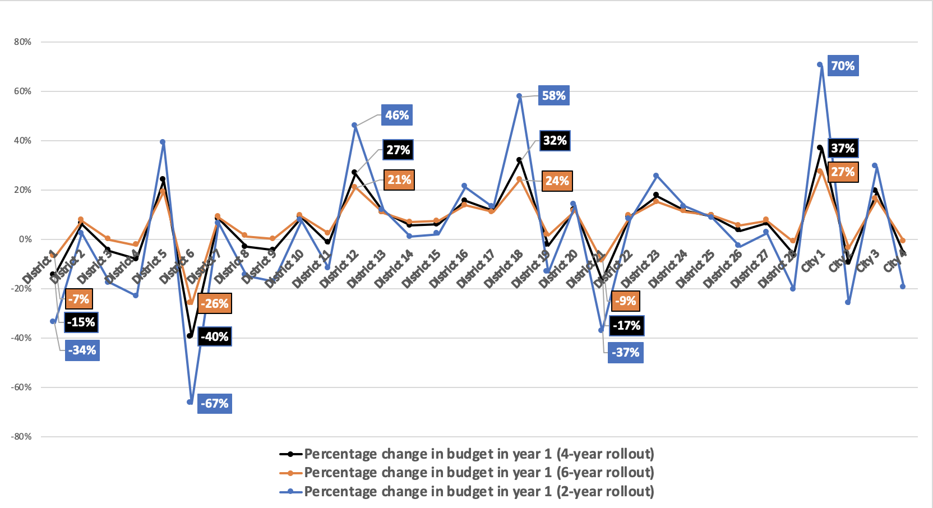
Pace of Change Simulations Option 3

Slide 39
Resource Allocation Formula (RAF): Group Work
Grand Palace Hotel, Mzuzu
18 February 2019

Slide 40
Group Allocations
Group 1 – Neno DC, Mangochi DC, Blantyre DC, Blantyre City Council
Group 2 – Zomba DC, Mwanza DC, Chikwawa DC, Zomba City Council
Group 3 – Chiradzulu DC, Thyolo DC, Phalombe DC
Group 4 – Nsanje DC, Mulanje DC, Luchenza Municipal Council

Slide 41
Question 1
What are the three biggest essential sub-item expenditures undertaken by the DHO during a financial year? (eg. fuel, vehicle maintenance)

Slide 42
Question 2
What are the most important expenditures/activities which are adversely affected by financial constraints?

Slide 43
Question 3
Apart from population size and disease burden, are there any other sources of differences in health expenditures across districts? If yes, list these.

Slide 44
Question 4
Should the formula take into consideration contributions for drugs and commodities procured by NGOs and donors? should health budgets of districts with significant contributions from partners be scaled down?
 | Total Cost of service delivery |  | Government contribution to program | Total cost of service delivery borne by government
Programme | District 1 | District 2 |  | District 1 | District 2
HIV | 200,000,000 | 80,000,000 | 15% | 30,000,000 | 12,000,000
RMNCAH | 230,000,000 | 240,000,000 | 40% | 92,000,000 | 96,000,000
NCDs | 110,000,000 | 220,000,000 | 90% | 99,000,000 | 198,000,000
Total | 540,000,000 | 540,000,000 |  | 221,000,000 | 306,000,000
50%
50%
40%
60%

Slide 45

Question 4
Health Sector Budget Requirement for Blantyre DHO
Health Sector Budget Requirement for Blantyre Rural
Health Sector Budget Requirement for Blantyre City
What health services does the city/town/municipality councils provide? Comment on how districts with city/town/municipality councils should be accounted for in the resource allocation formula

Slide 46
Question 5
Among the options presented, which is your preferred option?
Option 1: Crude Population Allocation
Option 2: Standardized Mortality Rates
Option 3: EHP Need (Full Coverage)
Option 4: EHP Need (Realistic Coverage)
Option 5: EHP Need (Full Coverage net of Donor Contributions)

Slide 47
Question 6
For the preferred formula, please specify what sources of data should be used for the calculations.
Population
Mortality rates
Burden of disease/Expected number of disease cases:
Cost of treatment (use of drugs and supplies, laboratory tests, etc): Estimates of administrative costs
Partner contribution
Intervention coverage rates

Slide 48
Question 7
The change in the formula may result in allocations to some local authorities reducing in the next financial year, with others increasing. What do you propose should be done during the transition period to cushion those districts that are affected the most?
Long transition period with some districts suffering small negative shocks
Longer transition period with no district suffering any negative shocks
Short transition period with mechanisms to cushion the effect of the negative shock

Slide 49
Question 8
Should the formula for Drug budget allocation be different from ORT budget allocation?
Drug
ORT
EHP Needs = Number of patients requiring an intervention X Cost of intervention per patient per year
Standardised Mortality rate = Number of standardized deaths X Fixed allocation per death

Slide 50
Question 9
How often should the formula be reviewed?
Every year
Once in 2 years
Once in 5 years
Other, please specify

Slide 51
Question 10
Any other remarks

Slide 52
Purpose of this meeting
To discuss the rationale for developing a Resource Allocation Formula
To present the preliminary proposals and analysis on formula options
To get inputs from districts on proposed options and additional considerations to be taken into account
Notes:
Application of RAF for the distribution of health sector budget to local government agencies
In most countries, the delivery of primary and secondary care is the responsibility of local government agencies managing primary and secondary health facilities
Follows from the discussion on health benefits package – one instrument to facilitate the implementation of the EHP
Two parts of the session – theory and case study of Malawi - hands-on exercise on the tool developed for Malawi

Slide 53
Proposed Options
1. Crude population
2. Mortality Rates
3. EHP Cost
Option 3: EHP intervention need (full coverage)
Intervention categories included in the Essential Health Package
RMNCH
Vaccines
Malaria
IMCI
Community Health
NTDs
HIV/AIDS
Nutrition
TB
NCDs
Oral Health
Notes:
The formula should reflect the expected cost of delivering a standard package of services local agencies are expected to provide.

